Slide 1





Smart Animal Alert Fence System using IoT and AI for Crop Protection
VR SIDDHARTHA ENGINEERING COLLEGE, VIJAYAWADA
Department of Computer Science and Engineering
23CS5554: EPICS (Review-1)
Date
Batch No: 21
Batch Members with passport photograph
Paila Sai Praveen – 238W1A05A3
Madem Hemanth - 238W1A093
Gunturu Jehu Hemanth - 238W1A0582
Under the Guidance of
Dr. K. Rama Krishna
Associate Professor

Slide 2
1. Abstract:
The Smart Animal Alert Fence System is designed to protect farmlands from animal intrusions using IoT and AI-based technologies.
The system integrates multiple sensors — PIR, IR, Ultrasonic, LDR, and DHT11 — to detect animal movement, distance, and environmental conditions.
An ESP32 microcontroller processes the data and activates deterrent devices such as buzzers, LED lights, and ultrasonic repellents to scare animals away.
Captured images from ESP32-CAM are analysed using YOLO-based AI on a laptop with GPU for intelligent animal recognition.
Alerts are sent to the farmer through Wi-Fi or GSM modules, ensuring quick response. The system operates on solar power for sustainability and is demonstrated as a cardboard prototype for proof of concept.
This project aims to provide a low-cost, efficient, and smart solution for farmers to prevent crop damage and improve agricultural safety.
Key Words:
IoT, ESP32, Sensors, Smart Agriculture, YOLO, Animal Detection, GSM, Solar Power, Prototype

Slide 3
2. Objectives of the Project
To design and develop a smart fence system that can detect animal intrusions using multiple sensors such as PIR, IR, and Ultrasonic.
To process sensor data using an ESP32 microcontroller for quick decision-making and automatic triggering of deterrent actions.
To implement deterrent mechanisms such as buzzer, LED lights, ultrasonic sound, and water spray to safely scare away animals.
To capture images of detected animals using ESP32-CAM and perform AI-based recognition using YOLO for intelligent monitoring.
To send real-time alerts to farmers through Wi-Fi or GSM (SIM800L) modules for quick awareness and response.
To use renewable energy sources like solar power for sustainable operation in remote rural areas.
To demonstrate the working of the entire system as a cardboard prototype, showcasing its real-time functioning and feasibility.

Slide 4
3. Scope
The project aims to provide a cost-effective and smart security system for farmers to protect their crops from animal intrusions.
The system can be implemented in small farms, gardens, and agricultural fields with minor modifications.
The use of AI (YOLO) detection enables the system to identify and differentiate between animals and humans for accurate alerts.
The prototype demonstrates how multiple sensors and deterrent mechanisms can work together for real-time animal detection and prevention.
The model can be scaled up for larger fields using multiple ESP32 units connected through Wi-Fi or IoT networks.
The project supports environment-friendly operation using solar energy and non-harmful deterrents (sound, water, and light).
The system can be integrated with mobile applications in the future for live monitoring and data logging.

Slide 5
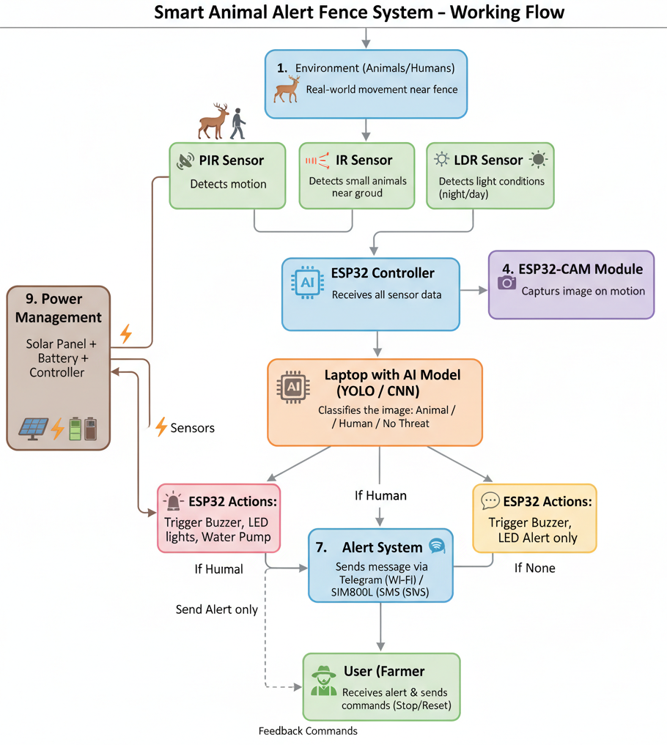
Existing System
Traditional fences (wooden or electric) are used to physically block animals, but they are expensive, dangerous, and ineffective for smaller animals.
Farmers often rely on manual monitoring or night watchmen, which is time-consuming and labor-intensive.
Summary of Design Thinking Findings
Low-cost, safe, and automated animal detection system using sensors and AI for accurate day/night monitoring with minimal false alerts.
Smart deterrents (sound, lights, water) that prevent intrusions without harming animals.
Portable, easy-to-install prototype with efficient power management (power bank/solar) for scalable field use.

Slide 6
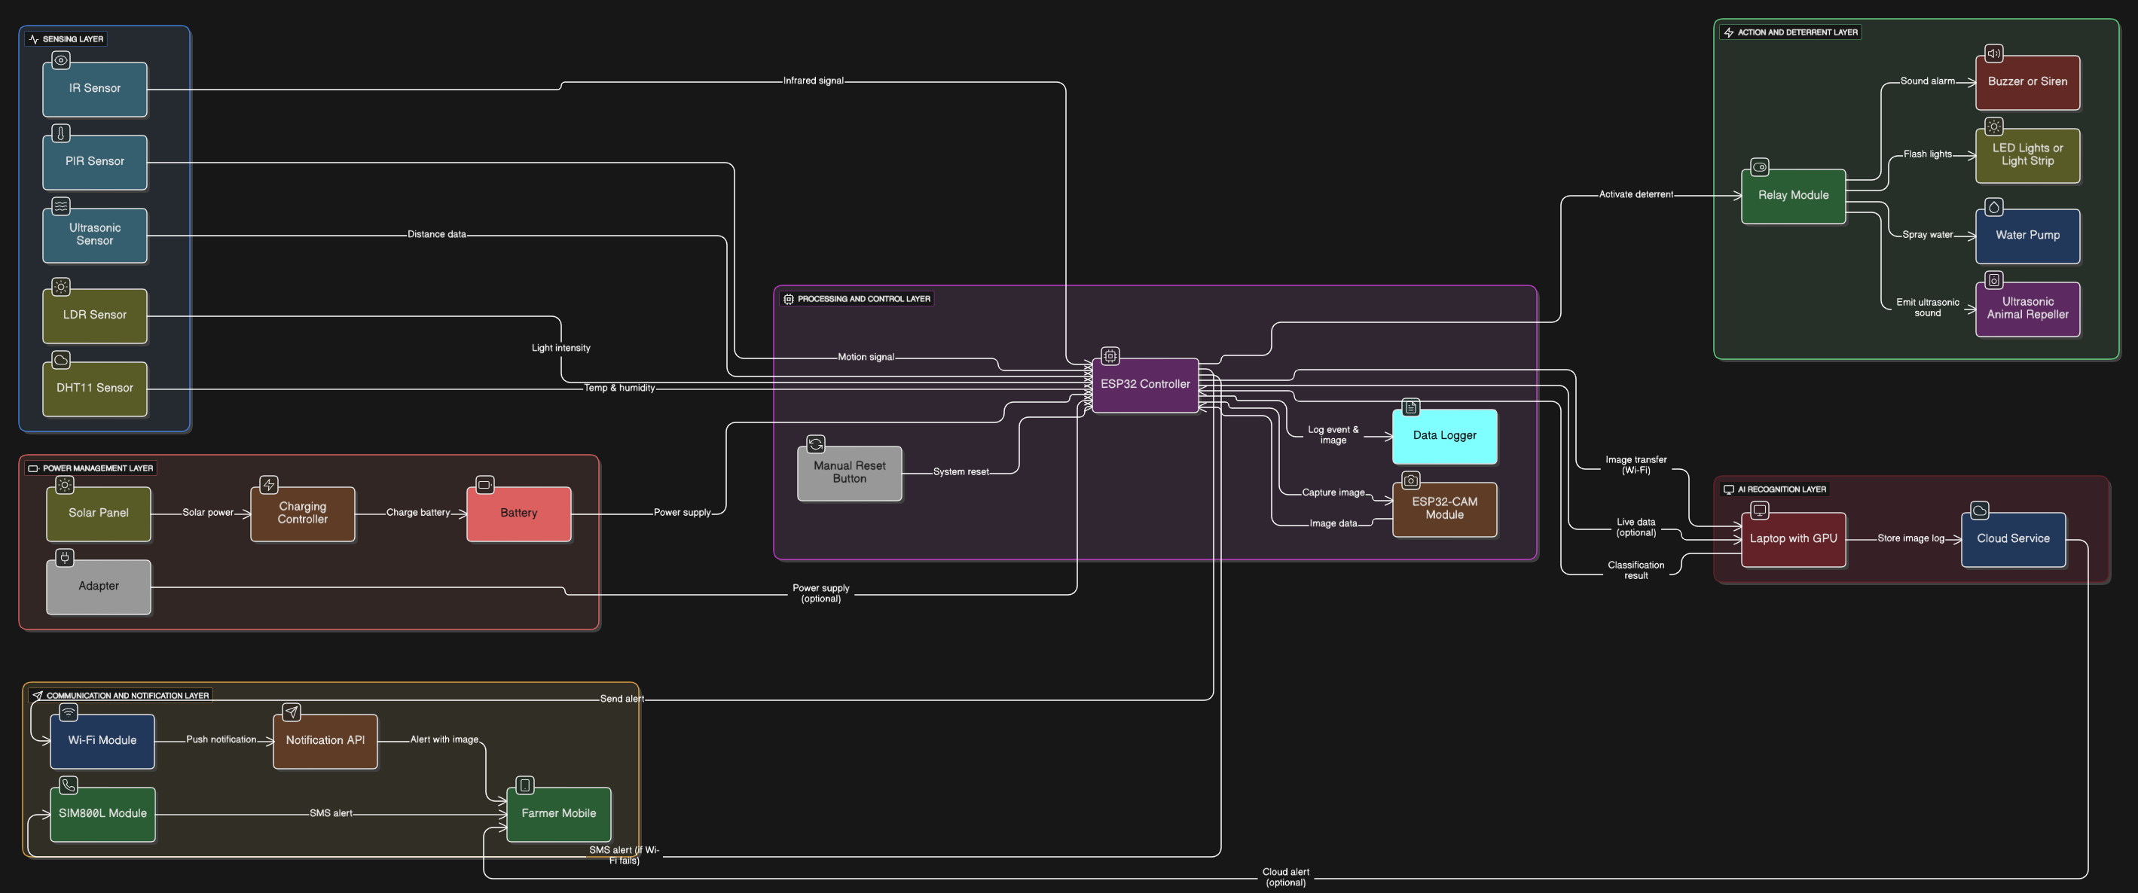
5. Proposed approach block diagram: methodology

Slide 7
6. Outcome of the Project
Effective Animal Detection: The system can detect animals using multiple sensors (PIR, IR, Ultrasonic) in real-time.
Automatic Deterrent Action: Buzzer, flashing LEDs, water spray, and ultrasonic repeller activate automatically to prevent crop damage.
AI-Based Recognition: ESP32-CAM with YOLO enables identification of animal types, reducing false alerts and improving accuracy.
Farmer Notification: Sends alerts via Wi-Fi or GSM (SMS), ensuring timely response even when the farmer is away.
Sustainable Operation: Powered by solar energy and battery, reducing dependency on conventional electricity.
Demonstrable Prototype: The cardboard-based model shows all system functionalities, making it suitable for evaluation and presentations.
Scalable Design: Can be scaled for larger farms or integrated with mobile apps for remote monitoring and logging.

Slide 8
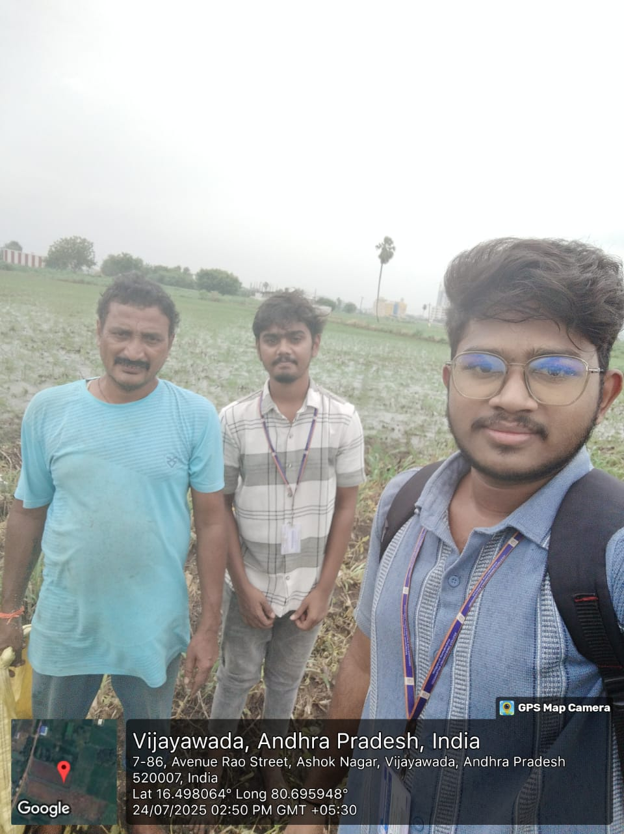
7. Client with photograph
During our field visit to Kanuru village, we met a farmer working in his field, who highlighted the challenges of crop damage caused by animal intrusion.
Our primary users are farmers who need a low-cost, safe, and automatic monitoring system.
Based on his inputs, the system is designed to work day and night with accurate detection and minimal false alerts, featuring smart, non-harmful deterrents like sound, lights, and water.
It is portable, easy to install, and energy-efficient, powered by a power bank or solar panel, ensuring scalable and practical field use.
Client Details
Name : Srikanth Uppaluri
Place : Kanuru
Phone Number : 9966142555

Slide 9
8. Progress update
Research & Planning:
Studied existing animal deterrent systems and IoT-based smart fencing solutions.
Finalized project architecture and required components.
Component Procurement:
Sensors (PIR, IR, Ultrasonic, LDR, DHT11), ESP32, ESP32-CAM, relay, LEDs, buzzer, battery, SIM800L purchased.
Prototype Development:
Set up cardboard-based demo to demonstrate sensors and ESP32 integration.
Connected actuators (LEDs, buzzer) to show real-time response.
ESP32-CAM tested for image capture and AI processing on laptop.
Software Implementation:
Sensor data acquisition code written and tested.
Basic AI (YOLO) detection implemented for image recognition.
SMS/push notification simulation working through ESP32.
Next Steps:
Integrate all layers (sensors → ESP32 → actuators → notifications).
Optimize AI detection and minimize false alerts.
Finalize prototype demonstration for panel evaluation.

Slide 10
THANK YOU

